Slide 1
Hypothesis Testing Process
Parametric
Correlations
Week 9

Slide 2
Recap
In Week 8
  Inferential statistics
  Comparing means
  Hypothesis testing process
  Types of Hypothesis
  Parametric Tests t-Tests, z-Tests
This week
  Hypothesis testing process
  Parametric Tests Anovas
  Correlations

Slide 3
Parametric tests
ANOVA
  One way ANOVA
  Factorial ANOVA
  Repeated ANOVA
  ANOVA for Split-Plot Design

Slide 4

Types of statistical test
Step 4
Choose the statistical test
Data | Test type | Sample size | Data distribution | Variance | Outliers | Statistical tests
Interval Scale without a fundamental zero | Parametric statistical test | Large sample | data is normally distributed | Equal variances | No Outliers | z-Tests
 |  |  |  |  |  | t-Tests
Ratio Scale with a fundamental zero
 |  |  |  |  |  | ANOVA
Nominal categorical | Non parametric statistical test | Small sample | data is NOT normally distributed | Unequal variances | Outlies | Chi-square Test
Ordinal Rank or order

Slide 5



Commonly used test in usability testing
Step 4
Choose the statistical test
Commonly Used Significance Tests for Comparing Means and Their Application Context
Experiment Design | Independent Variables (IV) | Conditions for each IV | Types of Test
Between-group | 1 | 2 | Independent-samples t test
 | 1 | 3 or more | One-way ANOVA
 | 2 or more | 2 or more | Factorial ANOVA
Within-group | 1 | 2 | Paired-samples t test
 | 1 | 3 or more | Repeated measures ANOVA
 | 2 or more | 2 or more | Repeated measures ANOVA
Between- and within-group | 2 or more | 2 or more | Split-plot ANOVA

Slide 6
ANOVA
ANOVA is a widely used statistical method that is used to check if the means of two or more groups are significantly different from each other.
When there are only two means to be compared, the calculation of ANOVA (ANalysis Of Variance) is simplified to t tests.
The hypothesis being tested in ANOVA is:
H₀: All pairs of samples are same i.e. all sample means are equal
H_{α}: At least one pair of samples is significantly different
H₀: μ₁ = μ₂ = μ₃
ANOVA tests normally return a value called the omnibus F (therefore, ANOVA tests are also called “F tests”). In ANOVA test we calculate F value and compare it with the critical value.
F = SSB / SSW, where
The mean sum of squares between the group SSB can be calculated as the following:
SSB = Sum of squares between groups (SSb) / Degrees of freedom between groups (DFb)
DFb = Degree of freedom (between the group) = K – 1 where K is the number of group
SSW = Sum of squares within groups (SSW) / Degrees of freedom within groups (DFw)

Slide 7
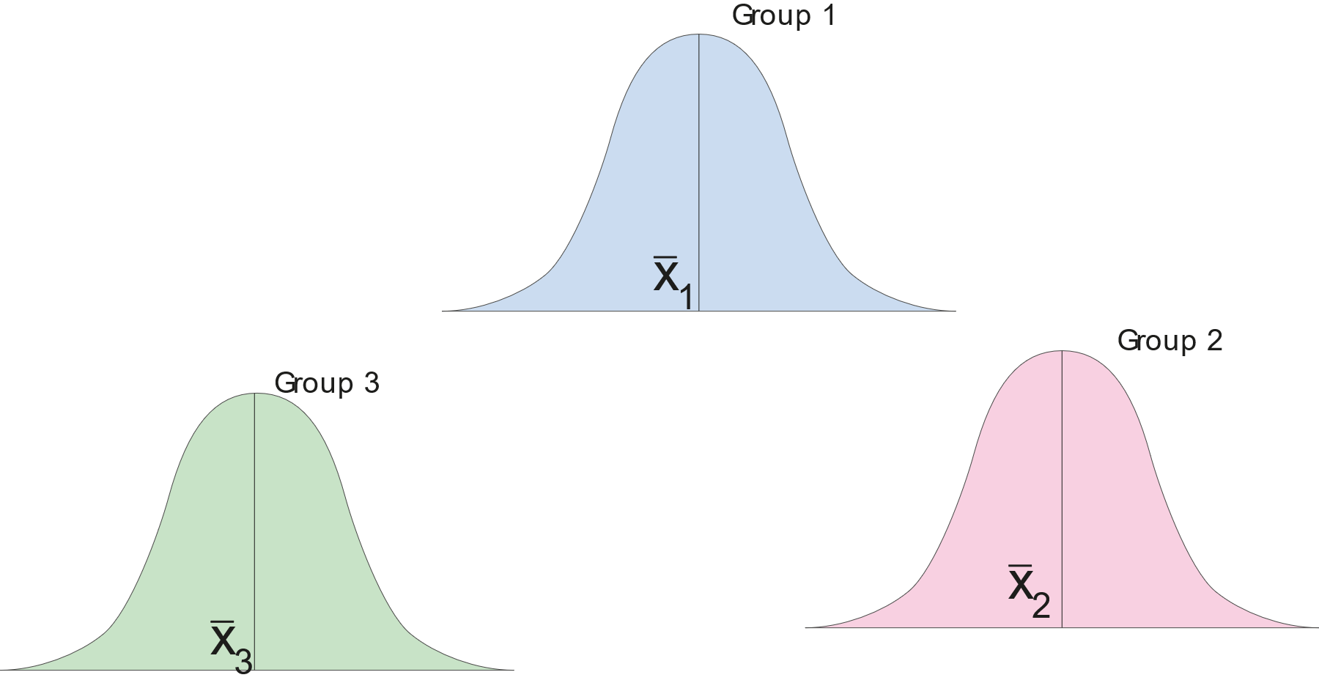


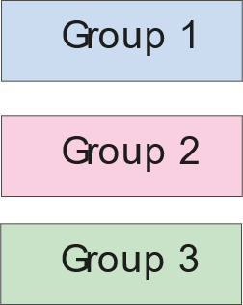
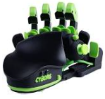
ANOVA – visual explanation
The typing speeds of the different groups using different keyboards
Three different groups of participants type some text using different keyboards. We collect their typing speed
Notes:
Suppose we want to compare THREE sample means to see if a difference exists somewhere among them
Is one so far away from the other two that is likely not from the same population?
Or all three are so far apart they All likely come from the same populations?

Slide 8
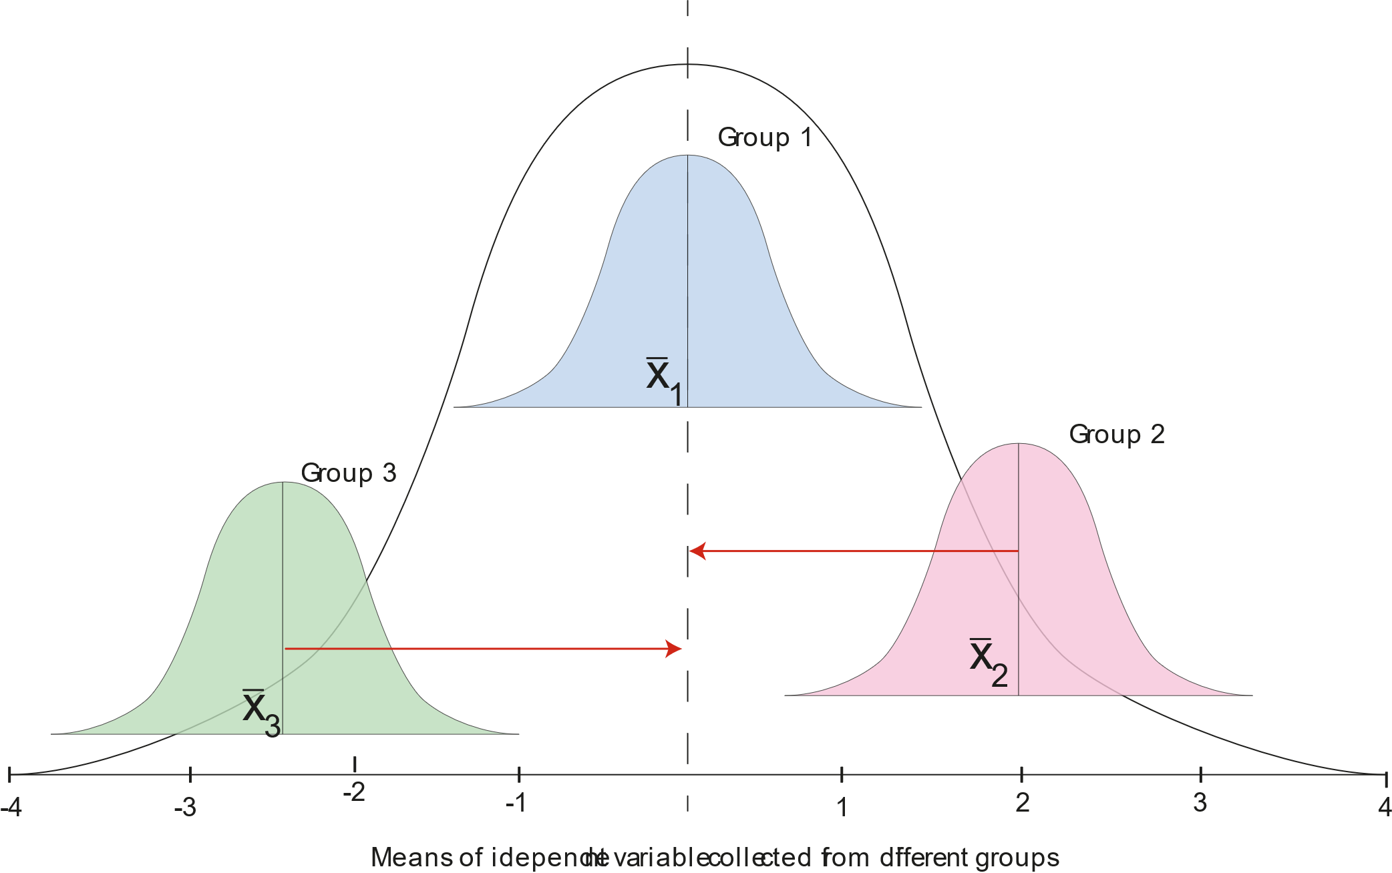
ANOVA – visual explanation
This curve represents a common distribution that contains all the data points of all three samples (the data collected from all groups, the datasets x1, x2, x3)
Groups type some text using different keyboards
Notes:
Suppose we want to compare THREE sample means to see if a difference exists somewhere among them
Is one so far away from the other two that is likely not from the same population?
Or all three are so far apart they All likely come from the same populations?

Slide 9
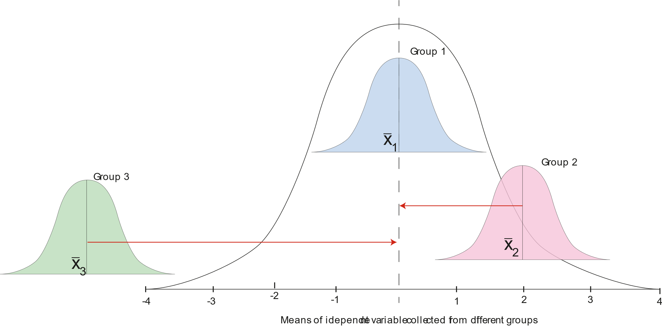
ANOVA – example 1
We examine the distance of the mean of each group from the larger mean.
This one is too far away from the other means of the larger group to be considered as part of the population
Oddball distribution
Groups type some text using different keyboards
Notes:
Suppose we want to compare THREE sample means to see if a difference exists somewhere among them
Is one so far away from the other two that is likely not from the same population?
Or all three are so far apart they All likely come from the same populations?

Slide 10
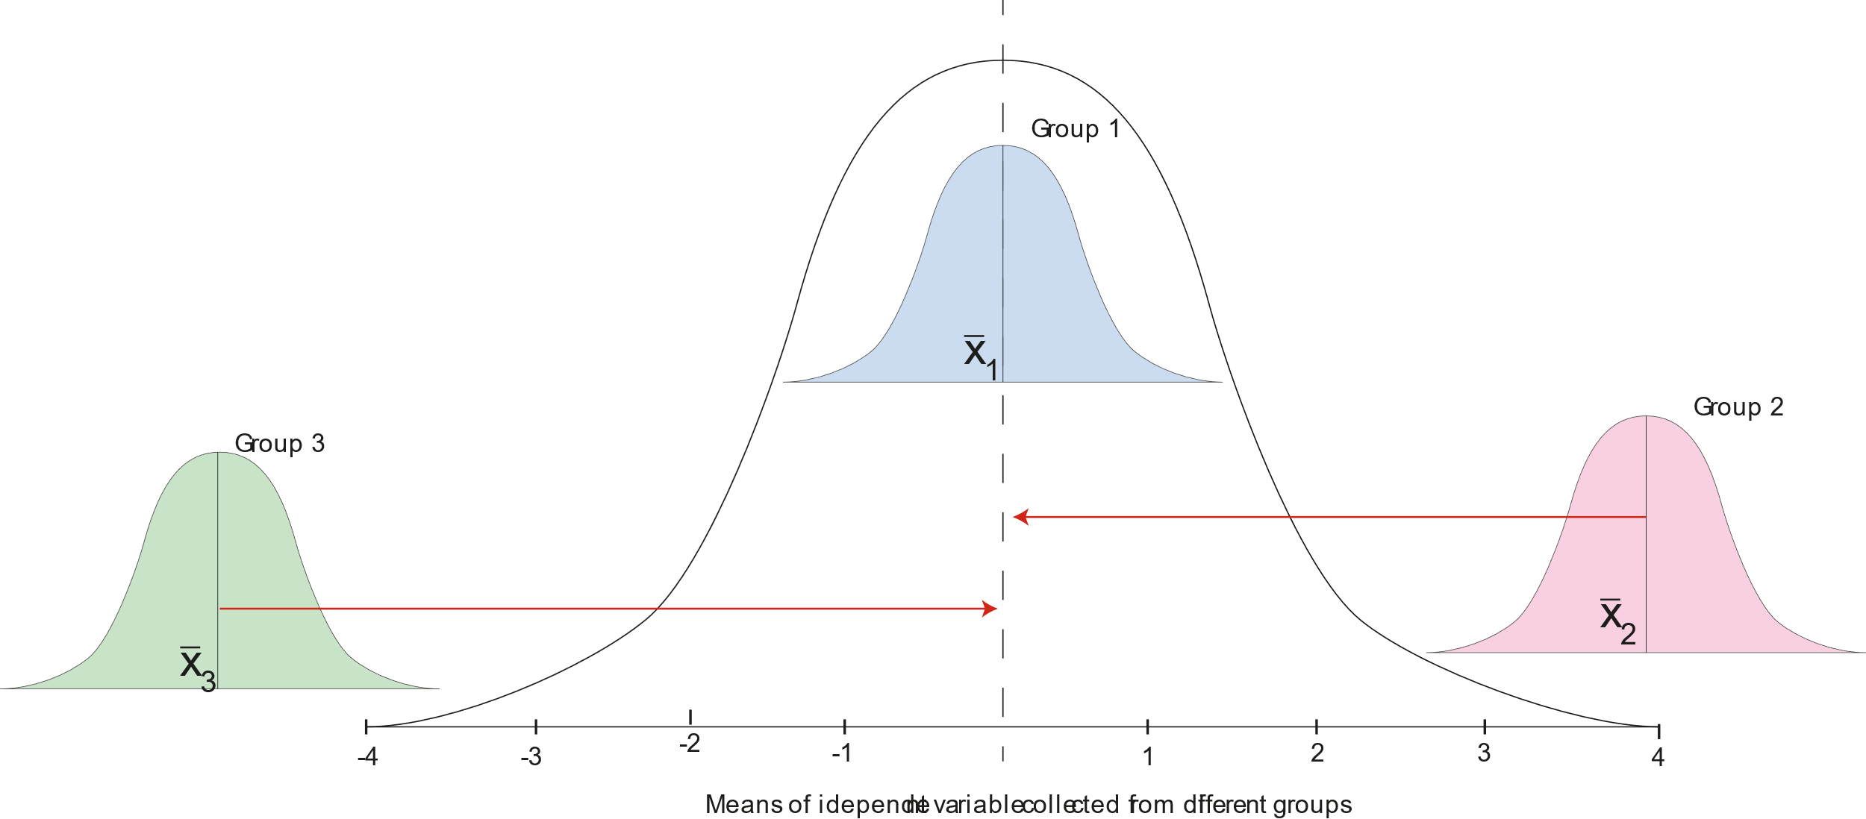
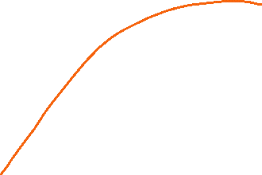


ANOVA – example 2
In this example both groups 2 and 3 are too far away from the mean of the larger group. Thus we can assume that in this case each of these samples belong to each own population.
Only x sub bar 1 belongs to this distribution in the background belongs
Groups type some text using different keyboards

Slide 11
ANOVA
Null hypothesis:
H₀: μ₁ = μ₂ = μ₃
What we examine is if those means come from the same population.
We are not looking if they are EXACTLY equal.
We are asking if each mean likely came from the larger overall population
Groups type some text using different keyboards
Notes:
Suppose we want to compare THREE sample means to see if a difference exists somewhere among them
Is one so far away from the other two that is likely not from the same population?
Or all three are so far apart they All likely come from the same populations?

Slide 12
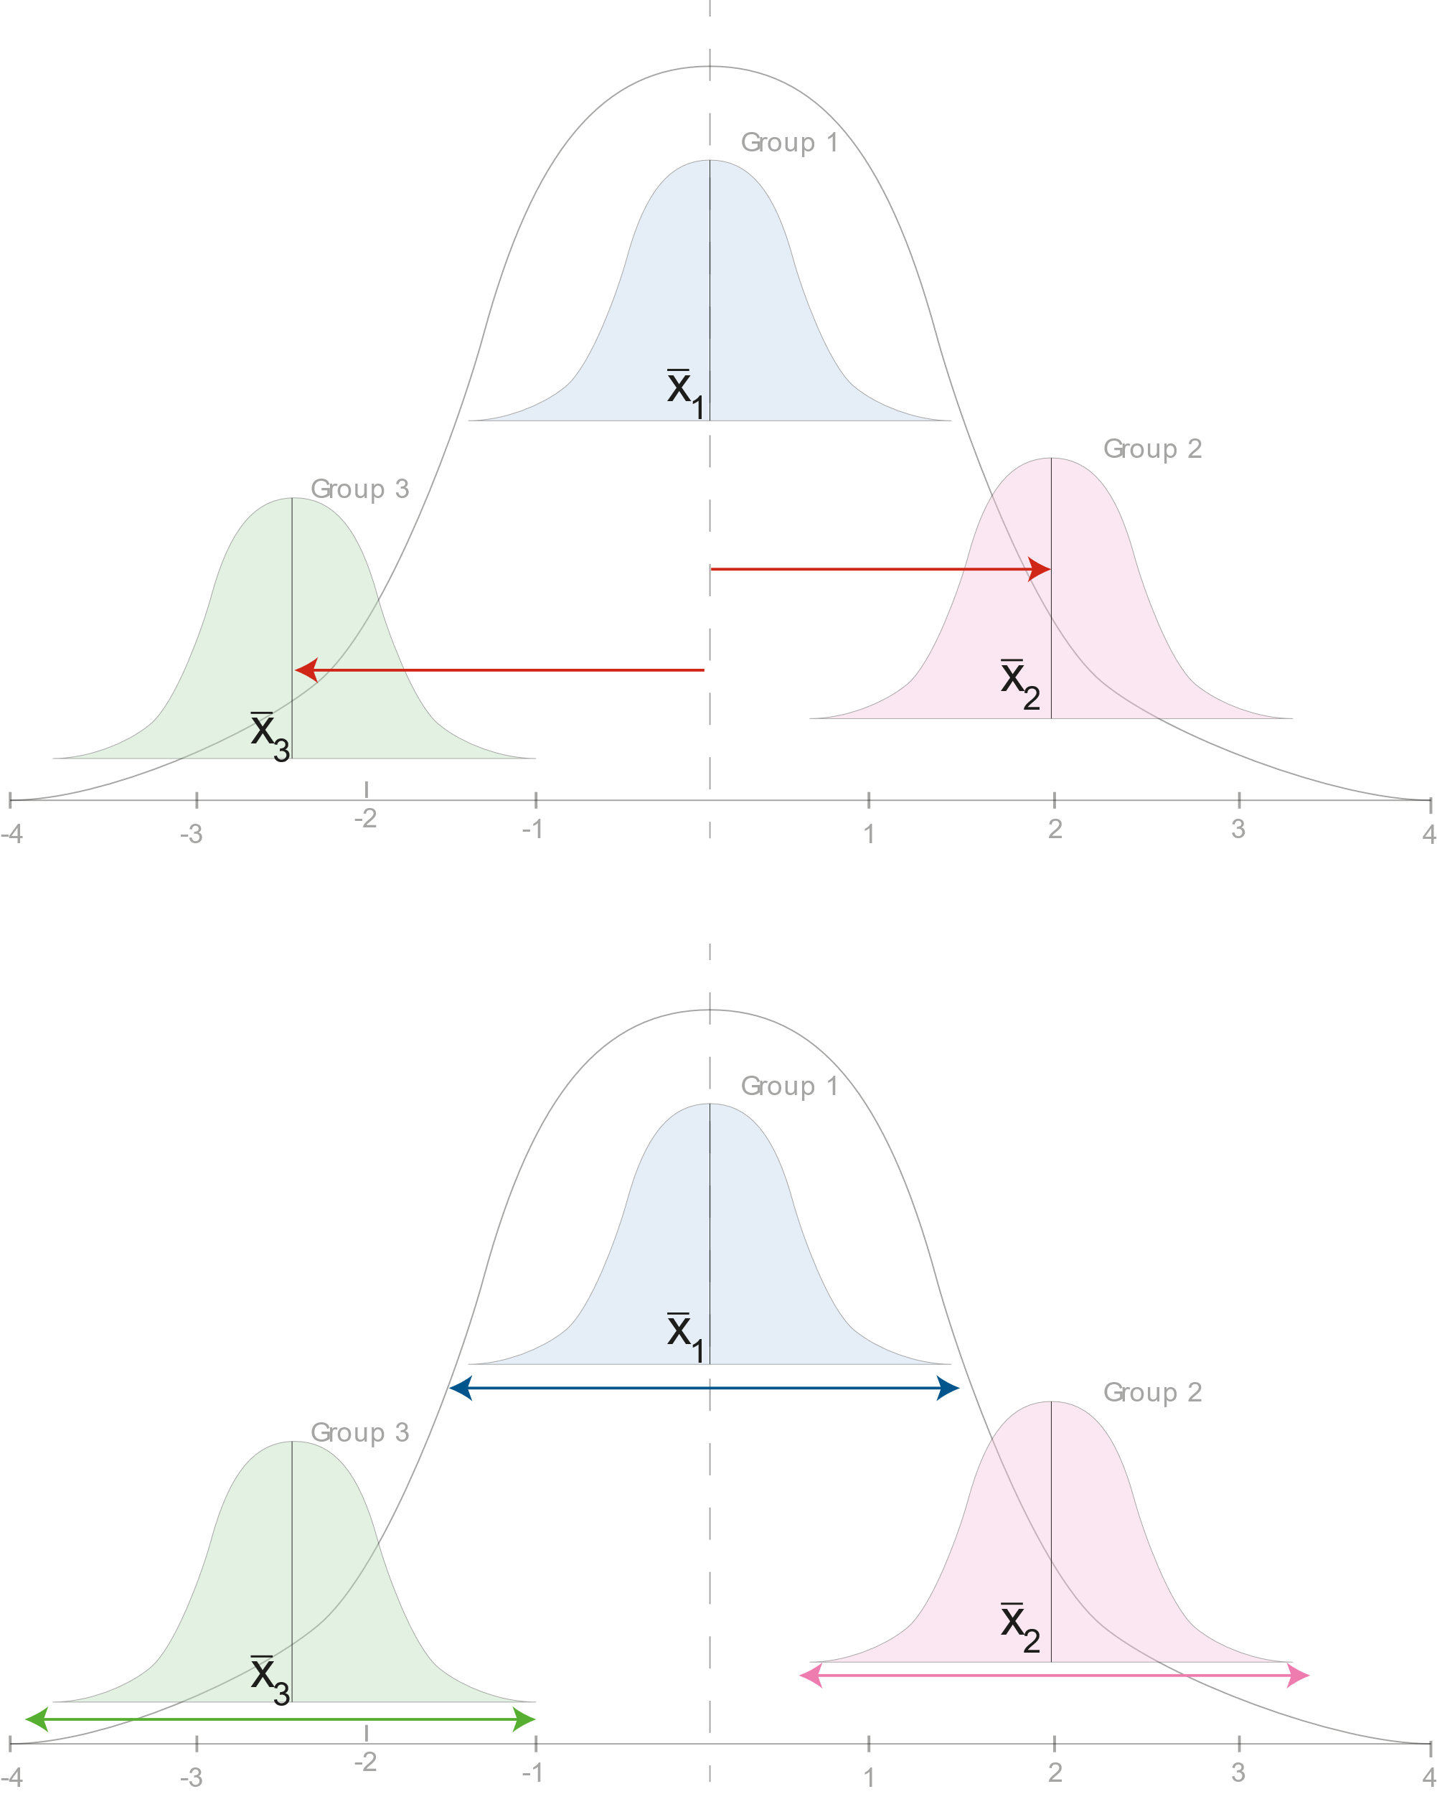
ANOVA: Analysis of variance is a variability ratio
Variability AMONG/BETWEEN the means
_{Distance from overall mean}
_{Variance Between}
₌
_{Variance Within}
Variability AROUND/WITHIN the distributions
_{Internal spread}

Slide 13
ANOVA: Analysis of variance is a variability ratio
Variance Between
Total Variance Components
Variance Within
“Partitioning” separating total variance into its component parts
Variance Between + Variance Within = Total Variance
If the variability BETWEEN the means (distance from the mean) in the numerator is relatively large compared to the variance WITHIN the samples (internal spread) in the denominator, the ratio will be much larger than 1. The samples then most likely do NOT come from a common population:
Reject Null Hypothesis that means are equal

Slide 14
ANOVA: Analysis of variance is a variability ratio
At least one mean is an outliner and each distribution is narrow; distinct from each other
LARGE
₌
Reject H₀
small
Variance Between
Means are fairly close to overall mean and/or distributions overlap a bit; hard to distinguish
Variance Within
similar
₌
Fail to Reject H₀
similar
The means are very close to overall mean and/or distribution are similar
Among
small
F =
₌
Fail to Reject H₀
Around
LARGE

Slide 15
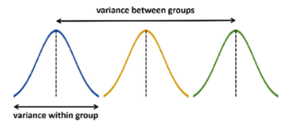
One way ANOVA
One-way ANOVA is appropriate for empirical studies that adopt a between-group design and investigate only one independent variable with three or more conditions.
Suppose you are interested in a speech-based data-entry method and would like to compare three conditions: text entry using standard word-processing software, text entry using word-prediction software, and text entry using speech-based dictation software.
The independent variable of the study has three conditions.
H_{o}: x̄ _{de_SWPS} - x̄ _{de_WPS} - x̄ _{de_SBSD} = 0 or H_{o}: x̄ _{de_SWPS} = x̄ _{de_WPS} = x̄ _{de_SBSD}
H_{a}: x̄ _{de_SWPS} - x̄ _{de_WPS} - x̄ _{de_SBSD} ≠ 0
Experimental Design?
Recruit three groups of participants and have each group complete the text entry task using one of the three methods. | Between group | One way ANOVA

Slide 16
Data organisation for one way ANOVA
Sample Data for One-Way ANOVA Test
Group | Participants | Task Completion Time | Coding
Standard | Participant 1 | 245 | 0
Standard | Participant 2 | 236 | 0
Standard | Participant 3 | 321 | 0
Standard | Participant 4 | 212 | 0
Standard | Participant 5 | 267 | 0
Standard | Participant 6 | 334 | 0
Standard | Participant 7 | 287 | 0
Standard | Participant 8 | 259 | 0
Prediction | Participant 9 | 246 | 1
Prediction | Participant 10 | 213 | 1
Prediction | Participant 11 | 265 | 1
Prediction | Participant 12 | 189 | 1
Prediction | Participant 13 | 201 | 1
Prediction | Participant 14 | 197 | 1
Prediction | Participant 15 | 289 | 1
Prediction | Participant 16 | 224 | 1
Speech | Participant 17 | 178 | 2
Speech | Participant 18 | 289 | 2
Speech | Participant 19 | 222 | 2
Speech | Participant 20 | 189 | 2
Speech | Participant 21 | 245 | 2
Speech | Participant 22 | 311 | 2
Speech | Participant 23 | 267 | 2
Speech | Participant 24 | 197 | 2
Notes:
The between-group's sum of squares represents the amount of variances in the data that can be explained by the use of text entry methods. The within-group's sum of squares represents the amount of variances in the data that cannot be explained by the text entry methods. The mean square is calculated by dividing the sum of squares by the degree of freedom. The returned F value of 2.174 is lower than the value at the 95% confidence interval, suggesting that there is no significant difference among the three conditions.

Slide 17
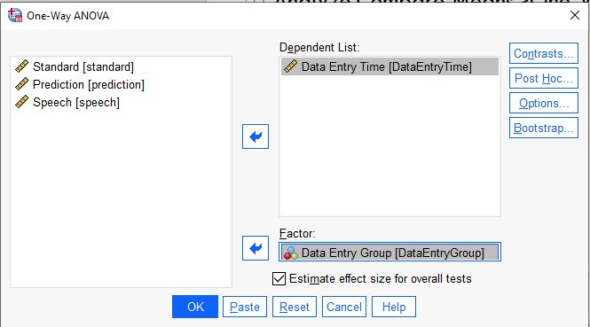
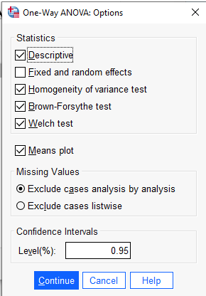
Run one way ANOVA in SPSS
Analyze.Compare Means>One-Way ANOVA

Slide 18
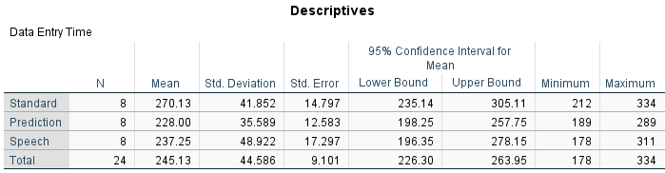
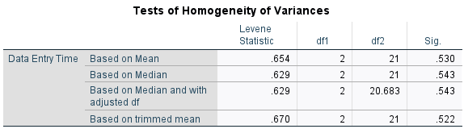
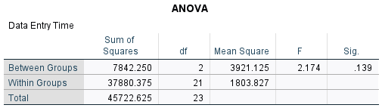
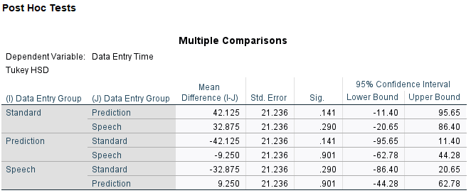
Results for one way ANOVA
Look at the example One-wayAnova.sav
Notes:
The between-group's sum of squares represents the amount of variances in the data that can be explained by the use of text entry methods. The within-group's sum of squares represents the amount of variances in the data that cannot be explained by the text entry methods. The mean square is calculated by dividing the sum of squares by the degree of freedom. The returned F value of 2.174 is lower than the value at the 95% confidence interval, suggesting that there is no significant difference among the three conditions.

Slide 19
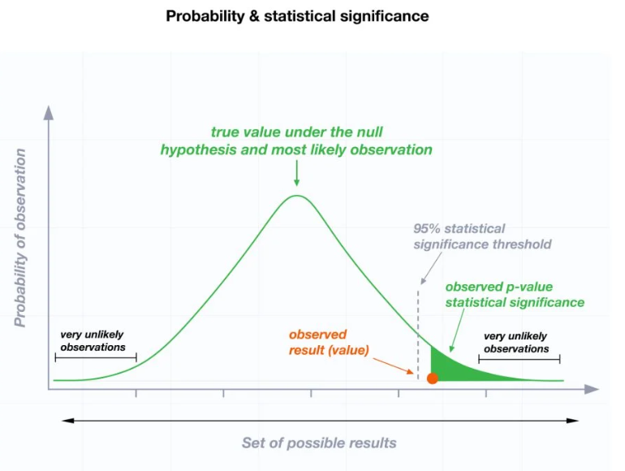
p-value
Is p < 0.05 ?

Slide 20
Interpretation of results for one way ANOVA
Look at the example One-wayAnova.sav
Look at the F. 95th Percentile Values on Blackboard
Is p < 0.05 ?
If the p-value is less than your chosen significance level (e.g. 0.05), then you can reject the null hypothesis and conclude that at least one of the population means is different from the others.
Notes:
The between-group's sum of squares represents the amount of variances in the data that can be explained by the use of text entry methods. The within-group's sum of squares represents the amount of variances in the data that cannot be explained by the text entry methods. The mean square is calculated by dividing the sum of squares by the degree of freedom. The returned F value of 2.174 is lower than the value (3.47 in the F 95th Percentile Values table) at the 95% confidence interval, suggesting that there is no significant difference among the three conditions.

Slide 21
Report the results
Report the results
  Short recap of the method
  Descriptive recap with standard deviations
  Significant test (with Anova and p-value)
  Hypothesis test recap

Slide 22
Report results for one way ANOVA
Look at the example One-wayAnova.sav
Twenty-four participants random sample completed a text entry task using one of the three methods (standard, prediction, speech).
A one-way ANOVA test using task completion time as the dependent variable and group as the independent variable suggests that there is no significant difference among the three conditions (F(2, 21) = 2.174, n.s.)
p(.139)>0.05
Therefore, the null hypothesis is confirmed.
Keep Null Hypothesis
No sig
p>0.05
Notes:
The between-group's sum of squares represents the amount of variances in the data that can be explained by the use of text entry methods. The within-group's sum of squares represents the amount of variances in the data that cannot be explained by the text entry methods. The mean square is calculated by dividing the sum of squares by the degree of freedom. The returned F value of 2.174 is lower than the value at the 95% confidence interval, suggesting that there is no significant difference among the three conditions.

Slide 23
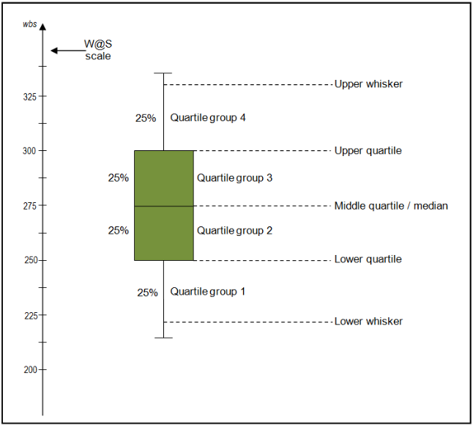
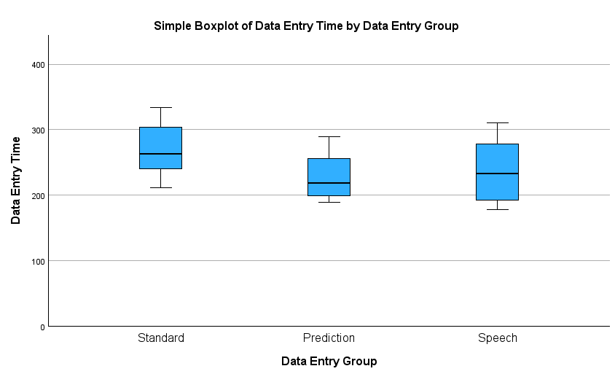
Boxplot interpretation
The boxplot enables us to study the distributional characteristics of standard, prediction and speech groups of scores as well as the level of the scores.
The Standard and Prediction group boxes are comparatively short (this suggests that overall typing speed is similar level). The Speech box is even in size compared to the other two groups.
Within the interquartile range of standard and prediction groups, a higher distribution is observed between the middle and upper quartiles, while the speech group is equally distributed between the lower and upper quartiles.
In the Prediction and Speech groups the upper whiskers are larger and represent scores outside the middle 50%. While in the Standard group shows almost equal distribution within the quartile group 1 and 4.
Understanding and interpreting boxplots
https://www.wellbeingatschool.org.nz/information-sheet/understanding-and-interpreting-box-plots

Slide 24
Factorial (two-way) ANOVA
Look at the example Factorial.sav
Factorial ANOVA is appropriate for empirical studies that adopt a between-group design and investigate two or more independent variables.
Suppose you are interested in a speech-based data-entry method and would like to compare three conditions: text entry using standard word-processing software, text entry using word-prediction software, and text entry using speech-based dictation software.
There are two conditions for the task type variable: transcription and composition
Experimental Design?
A Between-Group Factorial Design With Two Independent Variables
blank cell | Standard | Prediction | Speech
Transcription | Group 1 | Group 2 | Group 3
Composition | Group 4 | Group 5 | Group 6
Recruit six groups of participants and have each group complete the text entry task under one of the six conditions. | Between group | FactorialANOVA

Slide 25
Data organisation for Factorial ANOVA
Sample Data for the Factorial ANOVA Test
Task type | Entry method | Participant Number | Task time | Task Type coding | Entry Method coding
Transcription | Standard | Participant 1 | 245 | 0 | 0
Transcription | Standard | Participant 2 | 236 | 0 | 0
… | … | … | … | … | …
Transcription | Prediction | Participant 9 | 246 | 0 | 1
Transcription | Prediction | Participant 10 | 213 | 0 | 1
… | … | … | … | … | …
Transcription | Speech-based dictation | Participant 17 | 178 | 0 | 2
Transcription | Speech-based dictation | Participant 18 | 289 | 0 | 2
… | … | … | … | … | …
Composition | Standard | Participant 25 | 256 | 1 | 0
Composition | Standard | Participant 26 | 269 | 1 | 0
… | … | … | … | … | …
Composition | Prediction | Participant 33 | 265 | 1 | 1
Composition | Prediction | Participant 34 | 232 | 1 | 1
… | … | … | … | … | …
Composition | Speech-based dictation | Participant 41 | 189 | 1 | 2
Composition | Speech-based dictation | Participant 42 | 321 | 1 | 2
… | … | … | … | … | …
Composition | Speech-based dictation | Participant 48 | 202 | 1 | 2

Slide 26
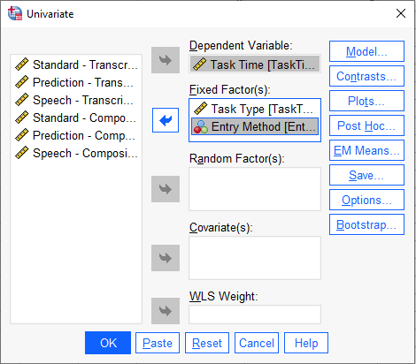
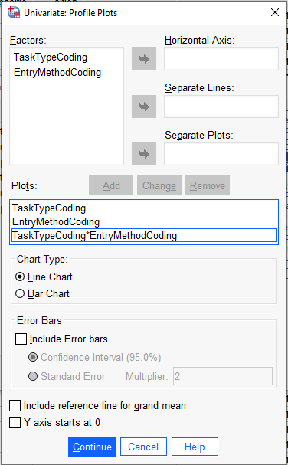
Factorial ANOVA in SPSS
Analyse > General Linear Model > Univariate

Slide 27
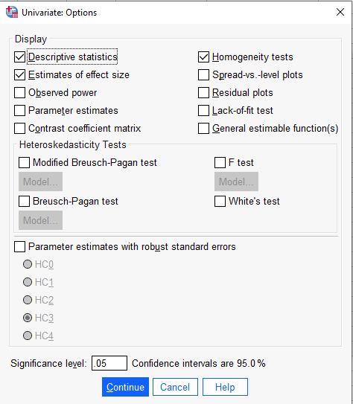
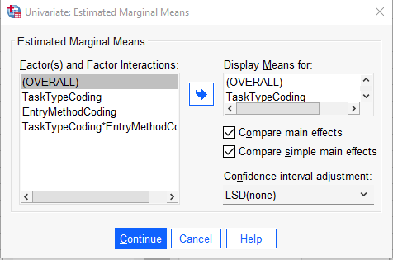
Factorial ANOVA in SPSS

Slide 28
Results for Factorial ANOVA
Result of the Factorial ANOVA Test
Source | Sum of Square | df | Mean Square | F | Significance
Task type | 2745.188 | 1 | 2745.188 | 1.410 | 0.242
Entry method | 17,564.625 | 2 | 8782.313 | 4.512 | 0.017
Task*entry | 114.875 | 2 | 57.437 | 0.030 | 0.971
Error | 81,751.625 | 42 | 1946.467 | — | —
Notes:
The between-group's sum of squares represents the amount of variances in the data that can be explained by the use of text entry methods. The within-group's sum of squares represents the amount of variances in the data that cannot be explained by the text entry methods. The mean square is calculated by dividing the sum of squares by the degree of freedom. The returned F value of 2.174 is lower than the value at the 95% confidence interval, suggesting that there is no significant difference among the three conditions.

Slide 29
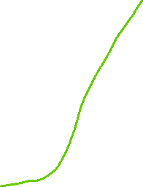
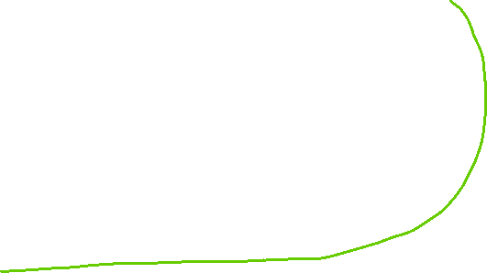
Interpretation of results for
Factorial ANOVA
The first and second rows list the information for the two independent variables.
The third row lists the information for the interaction effect between the two independent variables.
Result of the Factorial ANOVA Test
Source | Sum of Square | df | Mean Square | F | Significance
Task type | 2745.188 | 1 | 2745.188 | 1.410 | 0.242
Entry method | 17,564.625 | 2 | 8782.313 | 4.512 | 0.017
Task*entry | 114.875 | 2 | 57.437 | 0.030 | 0.971
Error | 81,751.625 | 42 | 1946.467 | — | —
The analysis result suggests that there is no significant difference between participants who completed the transcription tasks and those who completed the composition tasks (F(1, 42) = 1.41, n.s. , or p > 0.05).
There is a significant difference among participants who used different text entry methods
(F(2, 42) = 4.51, p < 0.05).
Is p < 0.05 ?
Look at the F. 95th Percentile Values on Blackboard for df 1, 42, is our F higher than the normal scores?
If YES the results are significant
Keep Null Hypothesis
Notes:
The between-group's sum of squares represents the amount of variances in the data that can be explained by the use of text entry methods. The within-group's sum of squares represents the amount of variances in the data that cannot be explained by the text entry methods. The mean square is calculated by dividing the sum of squares by the degree of freedom. The returned F value of 2.174 is lower than the value at the 95% confidence interval, suggesting that there is no significant difference among the three conditions.

Slide 30
Reporting the results for
Factorial ANOVA
Forty-eight participants random sample completed a text entry task of a transcript using one of the three methods (standard, prediction, speech) and of a composition using one of the three methods (standard, prediction, speech).
A factorial (two-way) ANOVA test using task completion time as the dependent variable and Task type group and Entry Method as the independent variables suggests that there is no significant difference between participants who completed the transcription tasks and those who completed the composition tasks (F(1, 42) = 1.41, n.s.).
There is a significant difference among participants who used different text entry methods
(F(2, 42) = 4.51, p < 0.05).
Therefore, the null hypothesis is rejected.
Result of the Factorial ANOVA Test
Source | Sum of Square | df | Mean Square | F | Significance
Task type | 2745.188 | 1 | 2745.188 | 1.410 | 0.242
Entry method | 17,564.625 | 2 | 8782.313 | 4.512 | 0.017
Task*entry | 114.875 | 2 | 57.437 | 0.030 | 0.971
Error | 81,751.625 | 42 | 1946.467 | — | —
Notes:
The between-group's sum of squares represents the amount of variances in the data that can be explained by the use of text entry methods. The within-group's sum of squares represents the amount of variances in the data that cannot be explained by the text entry methods. The mean square is calculated by dividing the sum of squares by the degree of freedom. The returned F value of 2.174 is lower than the value at the 95% confidence interval, suggesting that there is no significant difference among the three conditions.

Slide 31
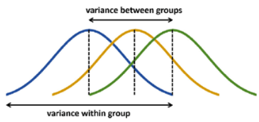
Repeated measures ANOVA
Repeated ANOVA is appropriate for empirical studies that adopt a within-group design and investigate two or more independent variables.
Suppose you are interested in a speech-based data-entry method and would like to compare three conditions: text entry using standard word-processing software, text entry using word-prediction software, and text entry using speech-based dictation software.
There are two conditions for the task type variable: transcription and composition, but you cannot have 72 participants that you would need for a between study as we saw before?
Experimental design with a smaller number of participants?
Experiment Design of a Two-Way, Repeated Measures ANOVA Test
blank cell | Standard | Prediction | Speech
Transcription | Group 1 | Group 1 | Group 1
Composition | Group 1 | Group 1 | Group 1
Recruit one group of participants and each participant completes the tasks under all conditions. | Within-group | Repeated Measures ANOVA

Slide 32
Data organisation for Repeated measures ANOVA
All six data points contributed by each participant should be listed in the same row
Sample Data for Two-Way, Repeated Measures ANOVA Test
blank cell | Transcription |  |  | Composition
blank cell | Standard | Prediction | Speech | Standard | Prediction | Speech
Participant 1 | 245 | 246 | 178 | 256 | 265 | 189
Participant 2 | 236 | 213 | 289 | 269 | 232 | 321
Participant 3 | 321 | 265 | 222 | 333 | 254 | 202
Participant 4 | 212 | 189 | 189 | 246 | 199 | 198
Participant 5 | 267 | 201 | 245 | 259 | 194 | 278
Participant 6 | 334 | 197 | 311 | 357 | 221 | 341
Participant 7 | 287 | 289 | 267 | 301 | 302 | 279
Participant 8 | 259 | 224 | 197 | 278 | 243 | 229

Slide 33
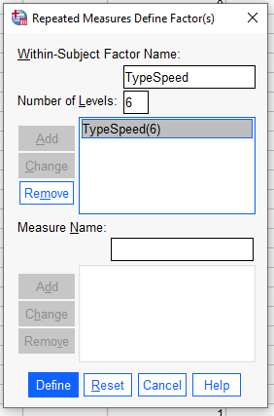
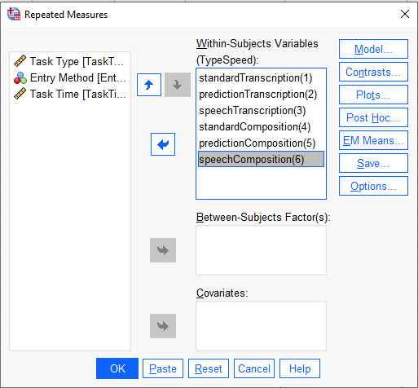
Repeated measures ANOVA in SPSS
Analyse > General Linear Model > Repeated Measures

Slide 34
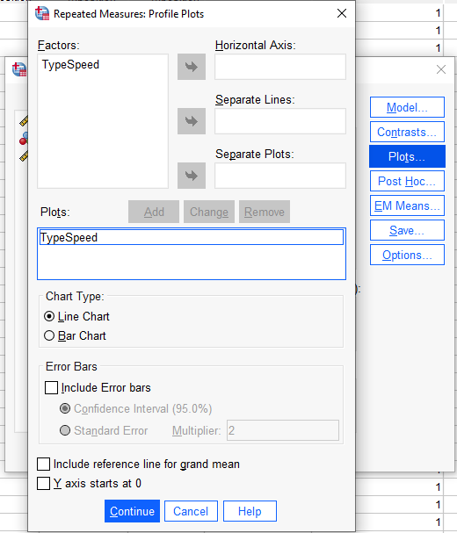
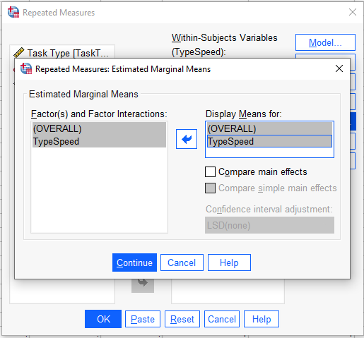
Repeated measures ANOVA in SPSS
Analyse > General Linear Model > Repeated Measures

Slide 35
Results for Repeated measures ANOVA
Result of the Two-Way, Repeated Measures ANOVA Test
Source | Sum of Square | df | Mean Square | F | Significance
Task type | 2745.187 | 1 | 2745.187 | 14.217 | 0.007
Error (task type) | 1351.646 | 7 | 193.092 | — | —
Entry method | 17,564.625 | 2 | 8782.313 | 2.923 | 0.087
Error (entry method) | 42,067.708 | 14 | 3004.836 | — | —
Task type*entry method | 114.875 | 2 | 57.438 | 0.759 | 0.486
Error (task type*entry method) | 1058.792 | 14 | 75.628 | — | —
Is p < 0.05 ?
Look at the F. 95th Percentile Values on Blackboard for df 1, 7 and 1, 14 is our F higher than the normal scores?
If YES the results are significant
Keep Null Hypothesis

Slide 36
Interpretation of results for
Repeated measures ANOVA
Is p < 0.05 ?
If YES the results are significant
Keep Null Hypothesis
Result of the Two-Way, Repeated Measures ANOVA Test
Source | Sum of Square | df | Mean Square | F | Significance
Task type | 2745.187 | 1 | 2745.187 | 14.217 | 0.007
Error (task type) | 1351.646 | 7 | 193.092 | — | —
Entry method | 17,564.625 | 2 | 8782.313 | 2.923 | 0.087
Error (entry method) | 42,067.708 | 14 | 3004.836 | — | —
Task type*entry method | 114.875 | 2 | 57.438 | 0.759 | 0.486
Error (task type*entry method) | 1058.792 | 14 | 75.628 | — | —
The task type has a significant impact on the time spent to complete the task (F(1, 7) = 14.217, p < 0.01).
There is no significant difference among the three text entry methods (F(2, 14) = 2.923, n.s.). The interaction effect between the two independent variables is not significant either (F(2, 14) = 0.759, n.s.).

Slide 37
ANOVA for Split-Plot Design
Look at the example Split-Plot-Anova.sav
Sometimes you may choose a study design that involves both between-group factors and within-group factors and investigate two or more independent variables with three or more conditions
Experimental Design – Between and within groups
A Between-Group Factorial Design With Two Independent Variables
blank cell | Standard | Prediction | Speech
Transcription | Group 1 | Group 1 | Group 1
Composition | Group 2 | Group 2 | Group 2
Recruit two groups of participants. One group completes transcription tasks using all three data-entry methods. The other group completes composition tasks using all three data-entry methods | Within-group & Between | Split-Plot ANOVA

Slide 38
Data organisation for
ANOVA for Split-Plot Design
Sample Data for the Split-Plot ANOVA Test
Task Type | Participant Number | Task Type Coding | Standard | Prediction | Speech
Transcription | Participant 1 | 0 | 245 | 246 | 178
Transcription | Participant 2 | 0 | 236 | 213 | 289
Transcription | Participant 3 | 0 | 321 | 265 | 222
Transcription | Participant 4 | 0 | 212 | 189 | 189
Transcription | Participant 5 | 0 | 267 | 201 | 245
Transcription | Participant 6 | 0 | 334 | 197 | 311
Transcription | Participant 7 | 0 | 287 | 289 | 267
Transcription | Participant 8 | 0 | 259 | 224 | 197
Composition | Participant 9 | 1 | 256 | 265 | 189
Composition | Participant 10 | 1 | 269 | 232 | 321
Composition | Participant 11 | 1 | 333 | 254 | 202
Composition | Participant 12 | 1 | 246 | 199 | 198
Composition | Participant 13 | 1 | 259 | 194 | 278
Composition | Participant 14 | 1 | 357 | 221 | 341
Composition | Participant 15 | 1 | 301 | 302 | 279
Composition | Participant 16 | 1 | 278 | 243 | 229

Slide 39
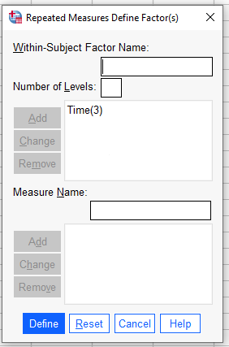
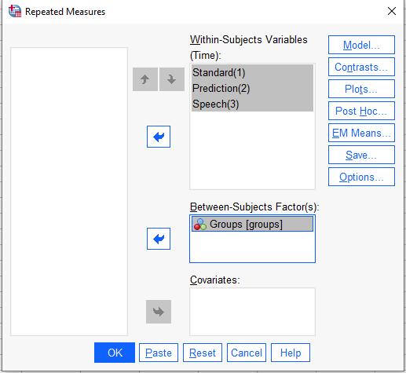
Split-Plot ANOVA in SPSS
Analyse > General Linear Model > Repeated Measures

Slide 40
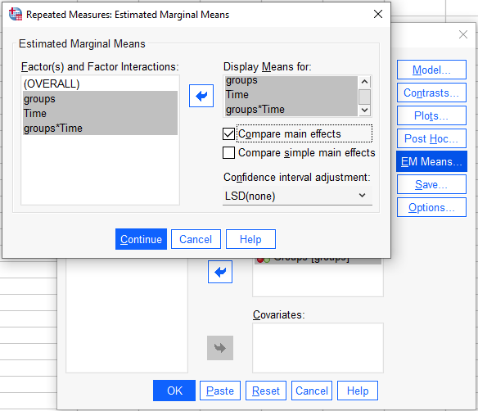
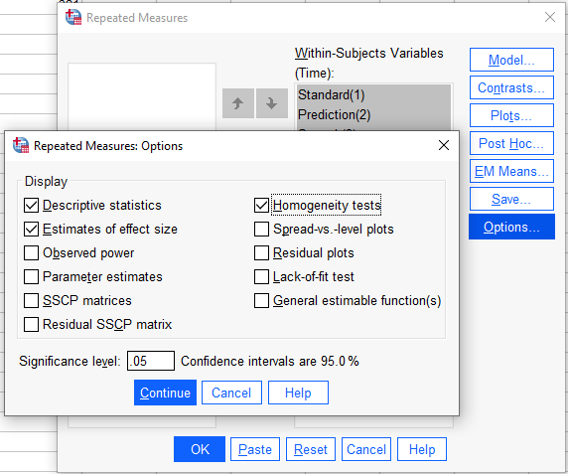
Split-Plot ANOVA in SPSS
Analyse > General Linear Model > Repeated Measures

Slide 41
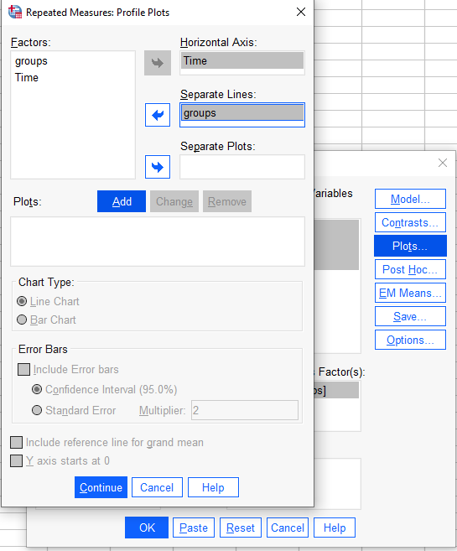
Split-Plot ANOVA in SPSS
Analyse > General Linear Model > Repeated Measures

Slide 42
Results for Split-Plot ANOVA
Results of the Split-Plot Test for the Between-Group Variable
Source | Sum of Square | df | Mean Square | F | Significance
Task type | 2745.187 | 1 | 2745.187 | 0.995 | 0.335
Error | 38,625.125 | 14 | 2758.937 | — | —
Look at the F. 95th Percentile Values on Blackboard for df 1, 14, is our F higher than the normal scores?
Results of the Split-Plot Test for the Within-Group Variable
Source | Sum of Square | df | Mean Square | F | Significance
Entry method | 17,564.625 | 2 | 8782.313 | 5.702 | 0.008
Entry method*task type | 114.875 | 2 | 57.437 | 0.037 | 0.963
Error (entry method) | 43,126.5 | 28 | 1540.232 | — | —
Is p < 0.05 ?
If YES the results are significant
Keep Null Hypothesis

Slide 43
Interpretation of results for
Split-Plot ANOVA
Results of the Split-Plot Test for the Between-Group Variable
Source | Sum of Square | df | Mean Square | F | Significance
Task type | 2745.187 | 1 | 2745.187 | 0.995 | 0.335
Error | 38,625.125 | 14 | 2758.937 | — | —
The between-group results suggest that there is no significant difference between participants who complete composition or transcription tasks (F(1, 14) = 0.995, n.s.).
The within-group results suggest that there is a significant difference among the three text entry methods (F(2, 28) = 5.702, p < 0.01).
The interaction effect between task types and text entry methods is not significant (F(2, 28) = 0.037, n.s.).
Is p<0.05?
Results of the Split-Plot Test for the Within-Group Variable
Source | Sum of Square | df | Mean Square | F | Significance
Entry method | 17,564.625 | 2 | 8782.313 | 5.702 | 0.008
Entry method*task type | 114.875 | 2 | 57.437 | 0.037 | 0.963
Error (entry method) | 43,126.5 | 28 | 1540.232 | — | —

Slide 44
Assumptions of t Tests and F Tests
That the conditions are exactly the same
There is a “homogeneity of variance” – we run the test when the variances in the populations are exactly the same variance. In cases this assumption is violated, we can use transformation techniques to make the variances in the sample population nearly equal.
The data is normally distributed – else we run non-parametric tests
Notes:
Before running a t test or an F test, it is important to examine whether your data meet the assumptions of the two tests. If the assumptions are not met, you may make incorrect inferences from those tests. Both t tests and F tests typically require three assumptions for the data:
First, the errors of all data points should be independent of each other. If they are not independent of each other, the result of the test can be misleading (Snedecor and Cochran, 1989). For example, in the text-entry method study, if two investigators conducted the study and one investigator consistently gave the participants more detailed instructions than the other investigator, the participants who completed the study with more detailed instructions might perform consistently better than those who received less detailed instructions. In this case, the errors of the participants who were instructed by the same investigator are no longer independent and the test results would be spurious.
Second, the errors in the data need to be identically distributed. This assumption is also called “homogeneity of variance.” When multiple group means are compared, the t test or the F test is more accurate if the variances of the sample population are nearly equal. This assumption does not mean that we can only run t tests or F tests when the variances in the populations are exactly the same. Actually, we only become concerned when the population variances are very different or when the two sample sizes are very different (Rosenthal and Rosnow, 2008). In cases when this assumption is violated, you can use transformation techniques, such as square roots, logs, and the reciprocals of the original data (Hamilton, 1990), to make the variances in the sample population nearly equal.
Third, the errors in the data should be normally distributed. Similar to the assumption of “homogeneity of variance,” this assumption is only considered to be violated when the sample data is highly skewed. When the errors are not normally distributed, nonparametric tests (discussed in Section 4.8) should be used to analyze the data.

Slide 45
Recap - types of ANOVA
Experimental design | Independent variables | Conditions | Types of ANOVA
Between-Group | 1 | 3 or more | One-way ANOVA
Between-Group | 2 or more | 3 or more | Factorial (two-way) ANOVA
Within-Group | 1 | 3 or more | Repeated ANOVA
Between-Group & Within-Group | 2 or more | 3 or more | Split Plot ANOVA

Slide 46
Identifying Relationships
One of the most common objectives for usability testing studies is to identify relationships between various factors. For example, you may want to know whether there is a relationship between age, computing experience, and target selection speed. In statistical terms, two factors are correlated if there is a significant relationship between them.
Pearson Correlation

Slide 47
Correlation
The most widely used statistical method for testing correlation is the Pearson's product moment correlation coefficient test
Rosenthal R, Rosnow R. Essentials of Behavioral Research: Methods and Data Analysis. third ed. Boston, MA: McGraw Hill; 2008.
This test returns a correlation coefficient called Pearson's r.
The value of Pearson's r ranges from − 1.00 to 1.00.

Slide 48
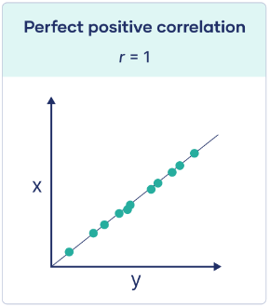
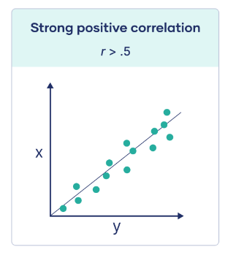
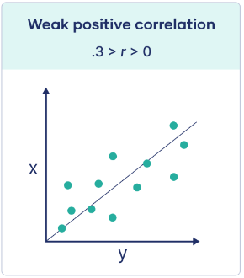
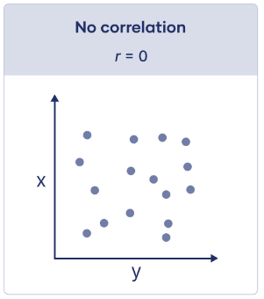
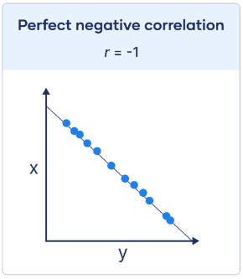
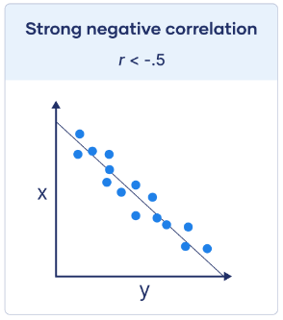
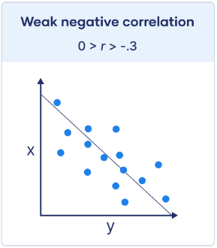
Pearson correlation coefficient
Pearson correlation coefficient (r) | Correlation type | Interpretation | Example
Between 0 and 1 | Positive correlation | When one variable changes, the other variable changes in the same direction. | Experience and performance: The higher the incentive, the longer the time spend on a website
0 | No correlation | There is no relationship between the variables. | The price of the subscription to a website and user performance
Between 0 and –1 | Negative correlation | When one variable changes, the other variable changes in the opposite direction. | Experience and performance: The longer the experience, the better the performance (faster)
Notes:
When the Pearson's r value between two variables is − 1.00, it suggests a perfect negative linear relationship between the two variables (any specific increase in the scores of one variable will perfectly predict a specific amount of decrease in the scores of the other variable).
When the Pearson's r value between two variables is 1.00, it suggests a perfect positive linear relationship between the two variables (any specific increase in the scores of one variable will perfectly predict a specific amount of increase in the scores of the other variable).
When the Pearson's r value is 0, it means that there is no linear relationship between the two variables. In other words, the increase or decrease in one variable does not predict any changes in the other variable.

Slide 49
Example Correlation
In the data-entry method example, suppose the eight participants each complete two tasks, one using standard word-processing software, the other using word-prediction software.
If we consider the number of years that each participant had used computers and the time they spent on each task. We can run three Pearson's correlation tests based on this data set to examine the correlation between:
  computer experience and task time under the standard word-processing software condition;
  computer experience and task time under the prediction software condition; and
  task times under the standard word-processing software condition and those under the prediction software condition.
RQ: Is there a relationship between computer experience and task time completion using different word-processing software?
H₀: There is no relationship between computer experience and task time completion using different word-processing software?
H_{a}: There is no relationship between computer experience and task time completion using different word-processing software?
The mathematical expression for the null hypothesis comparing correlation between two variables, X and Y, would be:
  H₀​: ρ_{XY}​=0
  X – the computer experience
  Y – task time completion

Slide 50

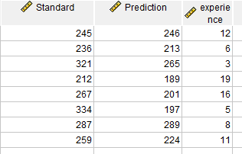
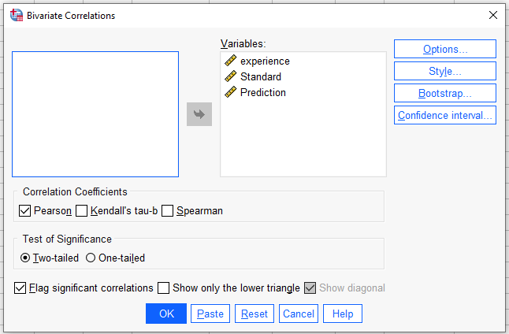
Data organisation in SPSS- Correlation
Look at the example correlation.sav
Analyse > Correlate > Bivariate

Slide 51
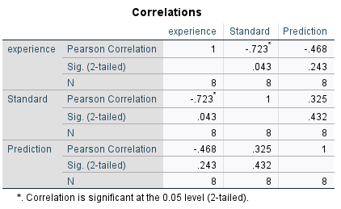
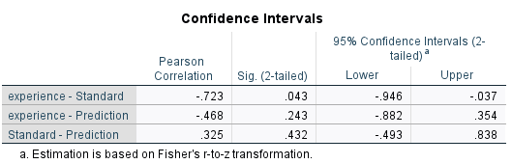





Results Correlations
The correlation between the same variable is always 1, as indicated by the three r values on the diagonal line of the table.
The correlation between computer experience and the time using the standard software is significant, with r value equal to − 0.723.
The negative r value suggests that as computer experience increases, the time spent on completing the task using the standard software decreases.
The correlation between computer experience and time spent using prediction software is not significant (r = − 0.468).
The correlation between the completion times using the standard software and using the prediction software is not significant either (r = 0.325).
Look at the Table of Critical Values: Pearson Correlation, for N 8 and 0.05 CI, is our value higher than the normal scores?

Slide 52
Report Correlation results
A Pearson correlation coefficient was computed to assess the linear relationship between computer experience and task time under the standard word-processing software condition; computer experience and task time under the prediction software condition; and task times under the standard word-processing software condition and those under the prediction software condition.
The correlation between computer experience and the time using the standard software is significant, with r value equal to − 0.723.
The negative r value suggests that as computer experience increases, the time spent on completing the task using the standard software decreases.
The correlation between computer experience and time spent using prediction software is not significant (r = − 0.468).
The correlation between the completion times using the standard software and using the prediction software is not significant either (r = 0.325).

Slide 53
Test your understanding
What is the difference between one-way and two-ways ANOVA?
How do I organise data in SPSS to conduct one-way or two-ways ANOVA?
What is factorial ANOVA?
How statistical significance is interpreted in ANOVA?
What is the difference between quantitative and categorical variables?
What is the definition of Pearson correlation coefficient?
When should I use Pearson correlation coefficient?
How do I interpret the Pearson correlation coefficient results?

Slide 54
Reading
Lazar, J. et al. (2017) Research methods in human-computer interaction. Second edition. Cambridge, Massachusetts: Morgan Kaufmann Publishers.
  Chapter 3 Experimental design
  Chapter 4. Statistical analysis
Online Resources
Turney, S. (2022, September 06). Pearson Correlation Coefficient (r) | Guide & Examples. Scribbr. Retrieved November 20, 2022, from https://www.scribbr.com/statistics/pearson-correlation-coefficient/
Understanding and interpreting boxplots
https://www.wellbeingatschool.org.nz/information-sheet/understanding-and-interpreting-box-plots

